Slide 1
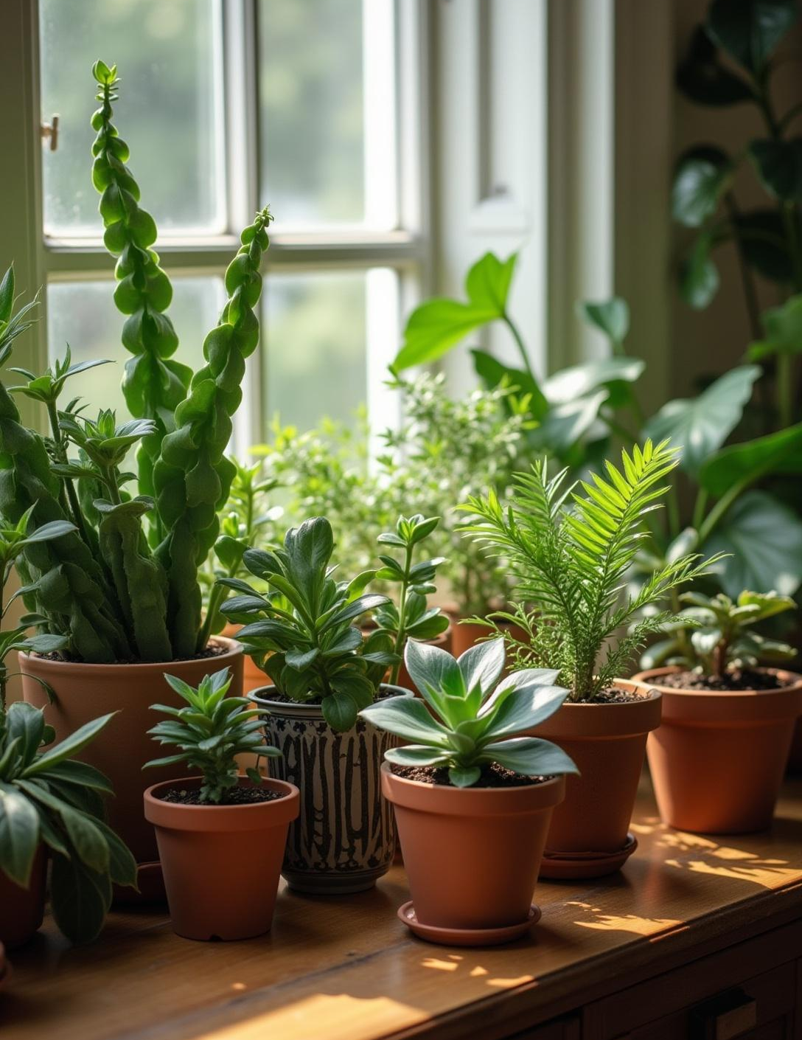
Indoor Plant Shopping Website
Names: Register Numbers:
V .SAI GANESH 22PA1A05H3
V. SRI DINESH 22PA1A05I2
R. A V D L SWAMY 22PA1A05E1
R. ANIRUDH SAKETH 22PA1A05E2
GitHub link: https://github.com/sridinesh04/ECOMMERCE-WEBSITE-PROJECT.git

Slide 2
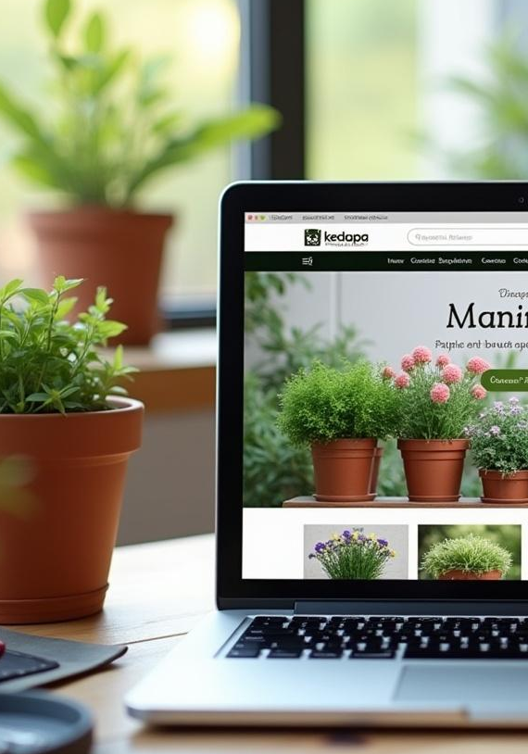
1. Project Overview
The Indoor Plant Shopping E-Commerce Website is a front-end web application designed to provide a seamless and engaging shopping experience for users interested in purchasing indoor plants. This project is built using HTML, CSS, and JavaScript, focusing on design aesthetics, responsiveness, and user interactivity. The platform showcases a variety of indoor plants with detailed descriptions, allowing users to browse, select, and add items to a virtual cart.
Purpose:
To create an elegant and responsive user interface for an online indoor plant store.To enhance plant accessibility for urban consumers who prefer indoor greenery.To simulate basic e-commerce functionality (browsing, cart system, and navigation) without a backend.
↓

Slide 3
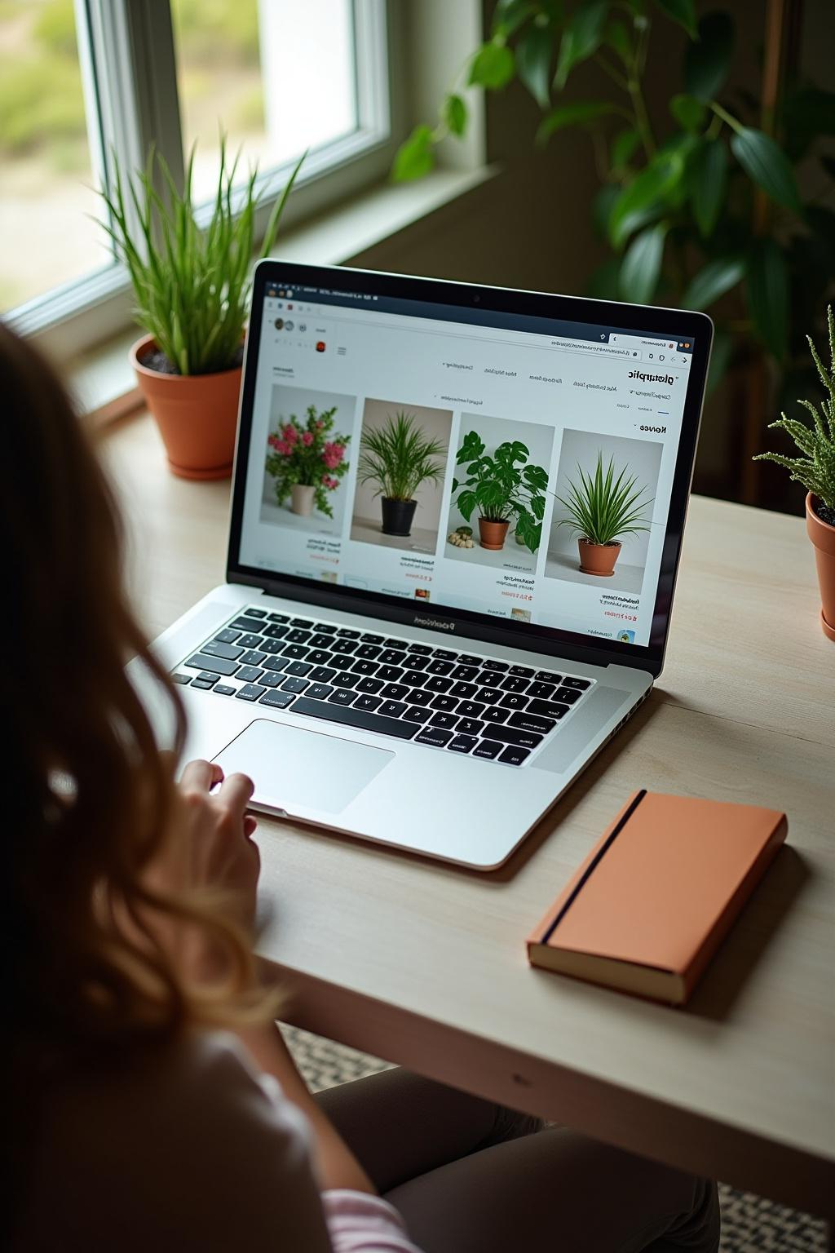
2. Objective & System Architecture
01
The main objective of this project is to design and develop a responsive, user-friendly front-end e-commerce platform for indoor plant shopping using HTML, CSS, and JavaScript. The system is built with the following goals:
Enable plant lovers to explore and purchase indoor plants online.
Provide a clean, aesthetic, and responsive UI for a better user experience.
Implement dynamic interactivity such as adding/removing items to/from the cart. Create a foundation that can later be extended with backend technologies and real-world deployment.

Slide 4
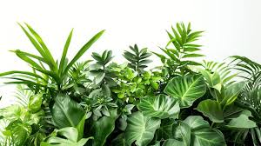
3. Key Features
The Indoor Plant Shopping E-Commerce Website is a fully responsive and interactive front-end web application developed using HTML, CSS, and JavaScript. It features a clean and modern user interface optimized for desktop, tablet, and mobile devices. The website allows users to browse a variety of indoor plants displayed in a grid layout, with each product showcasing an image, name, price, and an "Add to Cart" button. The shopping cart is managed entirely using JavaScript, enabling users to add items, update quantities, remove products, and view the total cost dynamically. The site includes a sticky and responsive navigation bar with links to key sections such as Home, Products, About, Contact, and Cart. The contact page features a validated form that allows users to send messages, while the About Us page introduces the platform’s mission and team. Smooth scroll effects, hover animations, and alert pop-ups enhance the overall user experience. The project maintains an organized folder structure, making it scalable for future enhancements like login functionality, payment integration, and backend support.
→

Slide 5
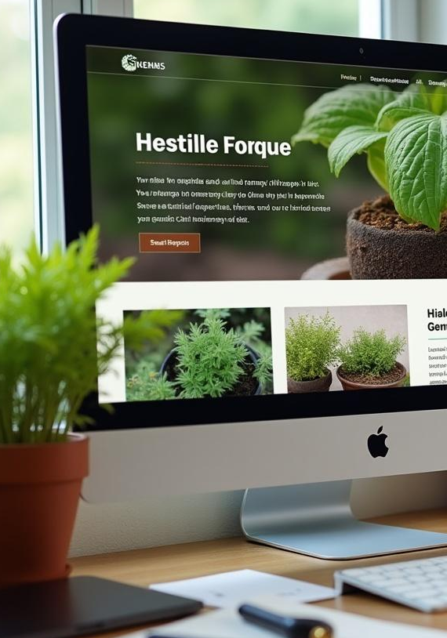
4. Technology Stack
🔹 Frontend:HTML5 – Used for creating the structure and semantic layout of all web pages.CSS3 – Used for styling, layout design, responsiveness, and animations.JavaScript (Vanilla JS) – Adds interactivity such as cart operations, dynamic total calculations, and form validation.
🔹 UI/UX Enhancements:Google Fonts – For modern and aesthetic typography.Font Awesome / Icons – To use attractive icons for UI elements like cart, navigation, and contact.Flexbox & CSS Grid – For responsive page layout and alignment.Media Queries – For ensuring the design adapts to different screen sizes.
🔹 Development Tools:Visual Studio Code (VS Code) – Code editor used for development.Browser Developer Tools – For live testing, debugging, and responsiveness checks.
↓

Slide 6
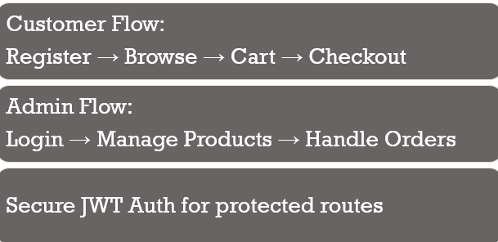
5. User Roles and Flow
→

Slide 7

6. Key API Endpoints
02
Endpoint | HTTP Method | Purpose
/api/plants | GET | Fetch all available indoor plants
/api/plants/:id | GET | Fetch a specific plant by ID
/api/plants | POST | Add a new plant (admin only)

Slide 8
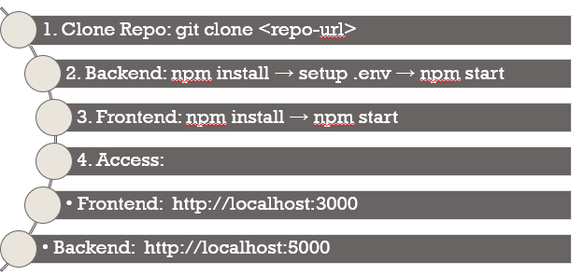
7. How to Run the Project
→

Slide 9
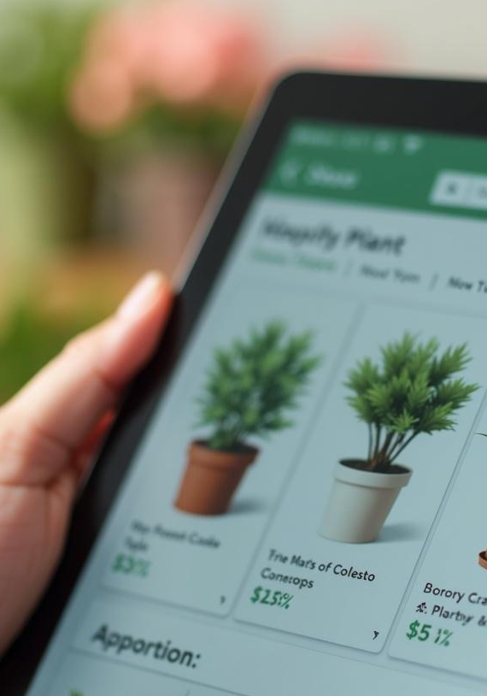
8. Future Enhancements
1.Payment Gateway Integration
Integrate with Razorpay, Stripe, or PayPal for online transactions.
Enable secure and seamless payment processing.
2.Backend Integration
Build a backend using Node.js + Express or Firebase.
Store and retrieve plant data dynamically from a MongoDB or Firestore database.
Admin dashboard to manage inventory
3. Product Filtering & Search
Filter plants by category (e.g., succulents, air-purifying, indoor flowering).
Implement real-time search functionality for product names.
4.Ratings & Reviews
Allow users to rate and review plants after purchase.
Display average ratings and recent reviews on product cards.
5.Multi-language Support
Use i18n (internationalization) libraries to provide content in multiple languages.
Attract a broader audience globally.
5.AI-Based Plant Suggestions
Suggest plants based on user browsing or cart history.
Display “You may also like” sections using basic machine learning logic.
↓

Slide 10
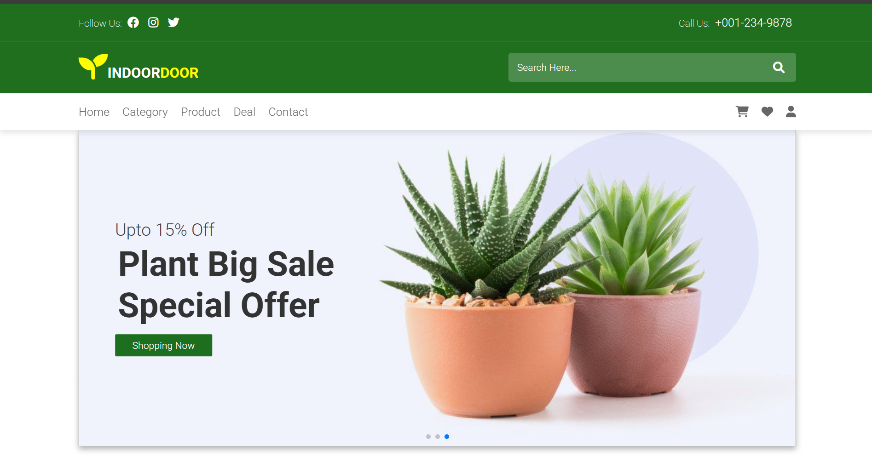
→

Slide 11
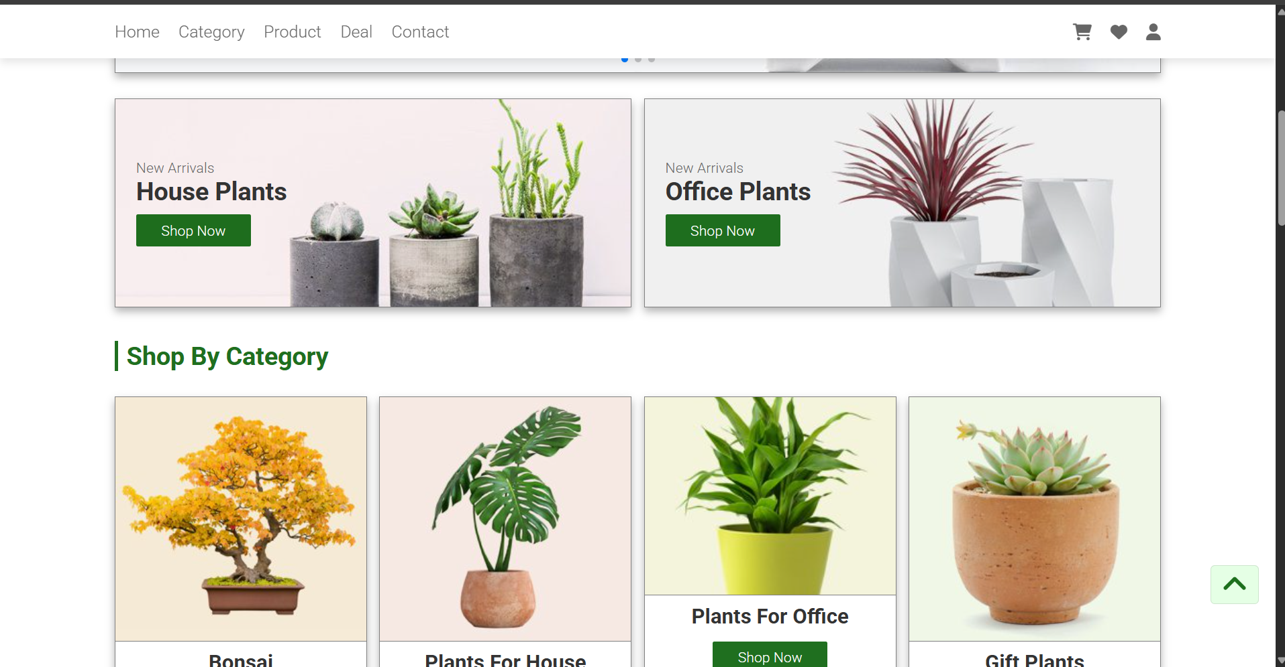
↓

Slide 12
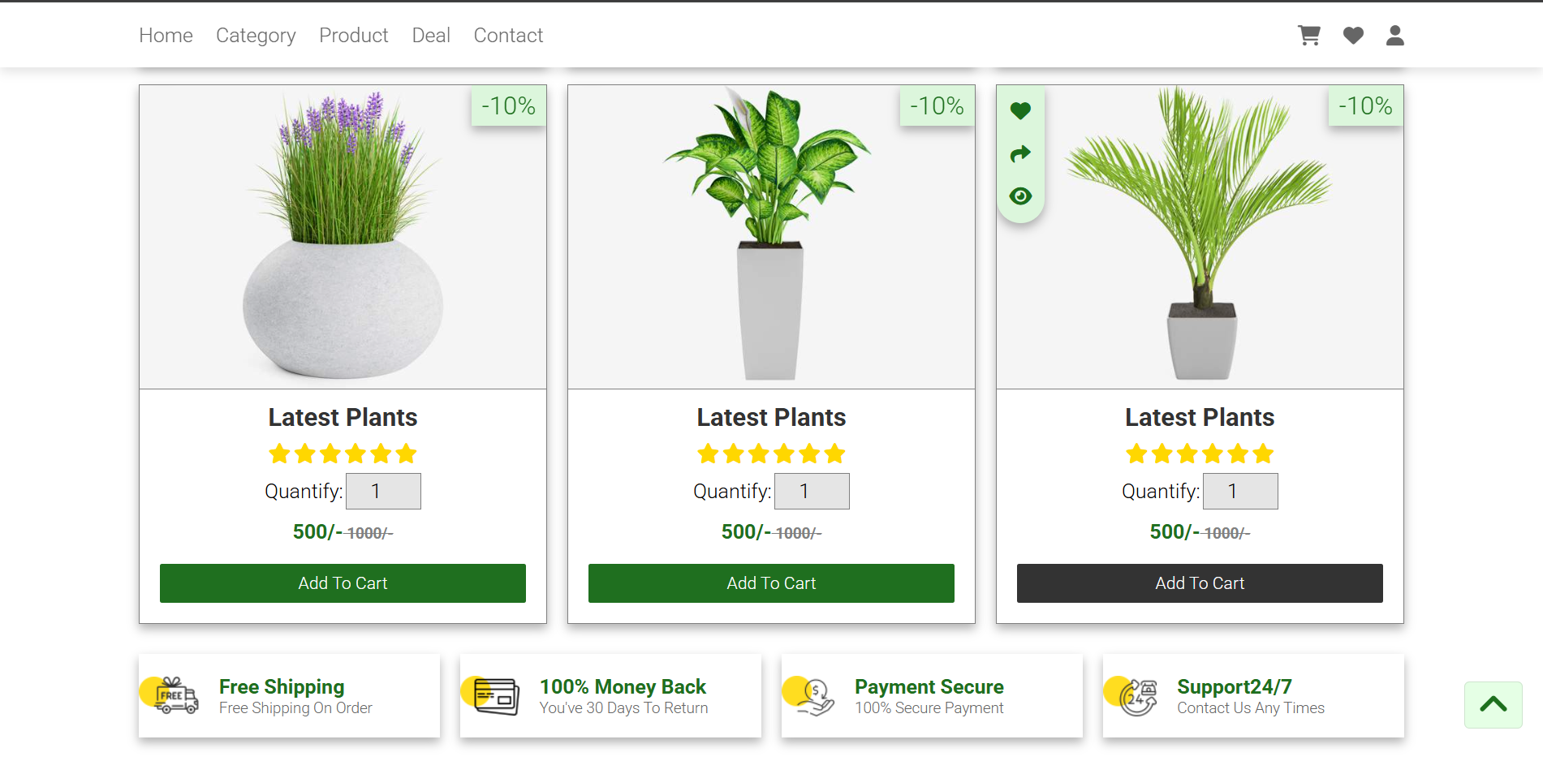

Slide 13
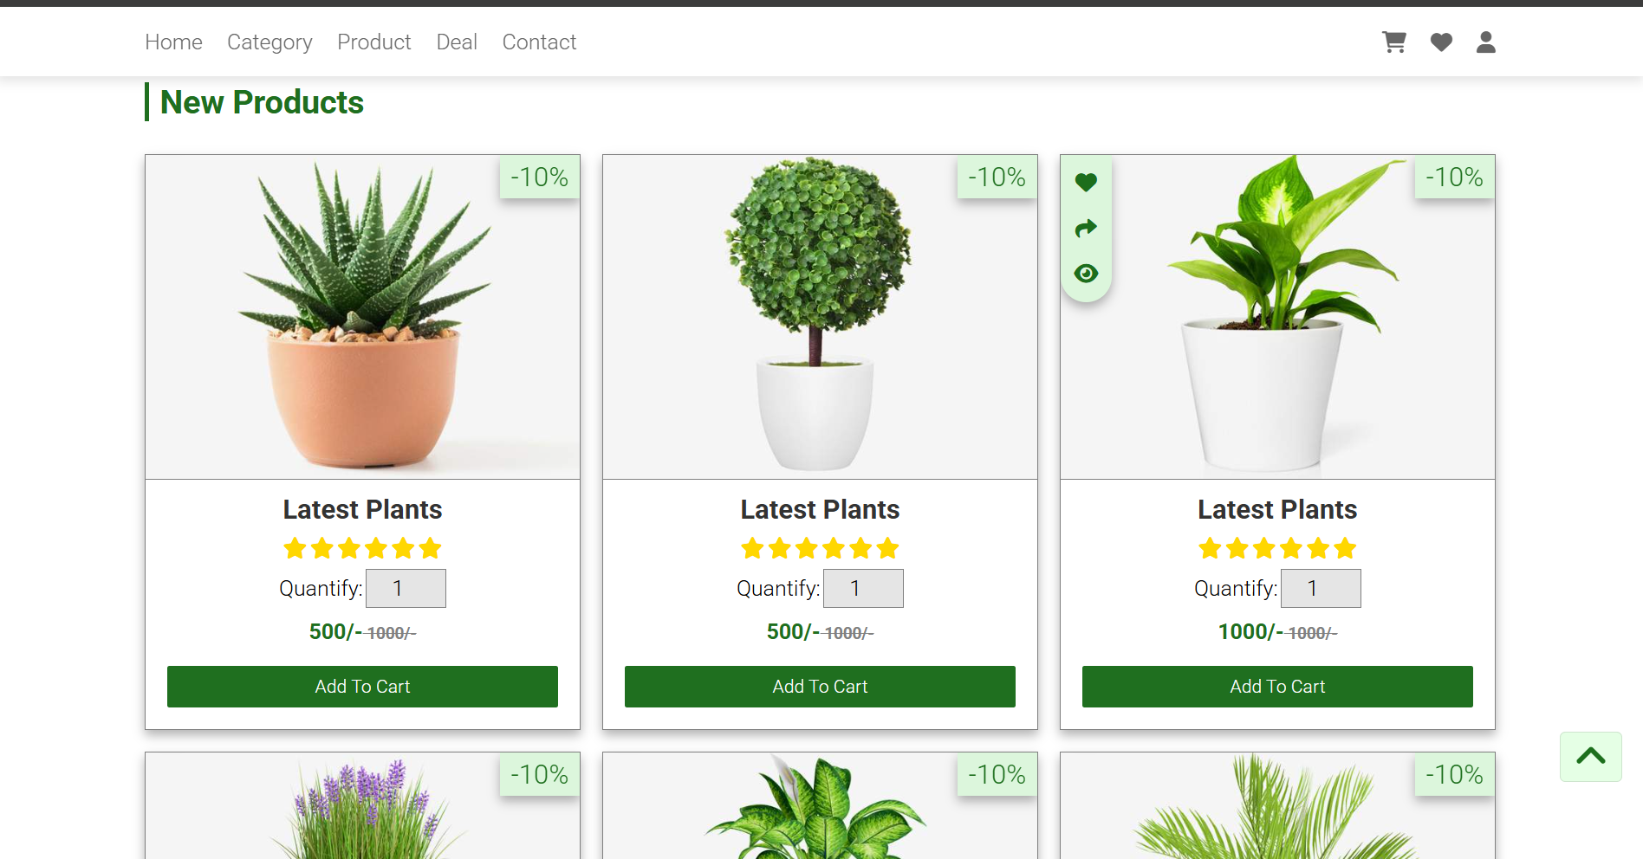

Slide 14
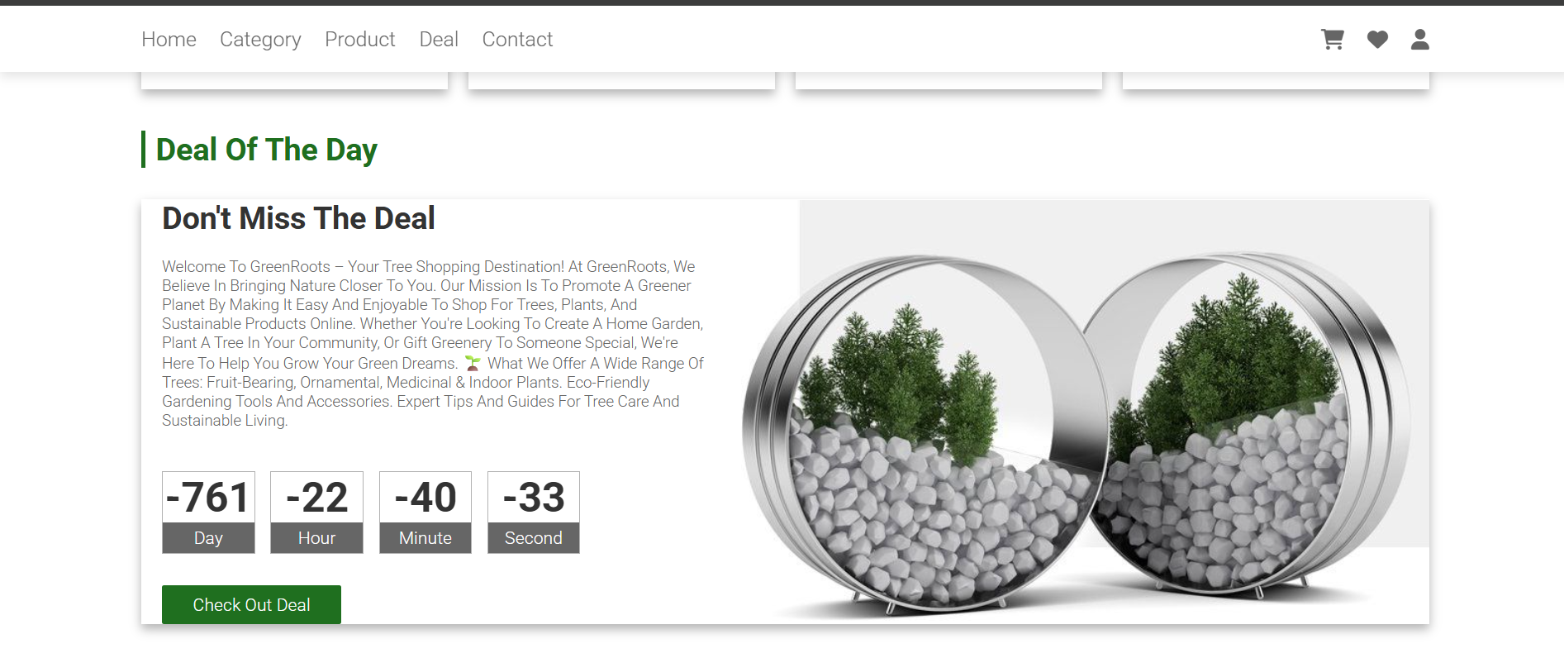

Slide 15
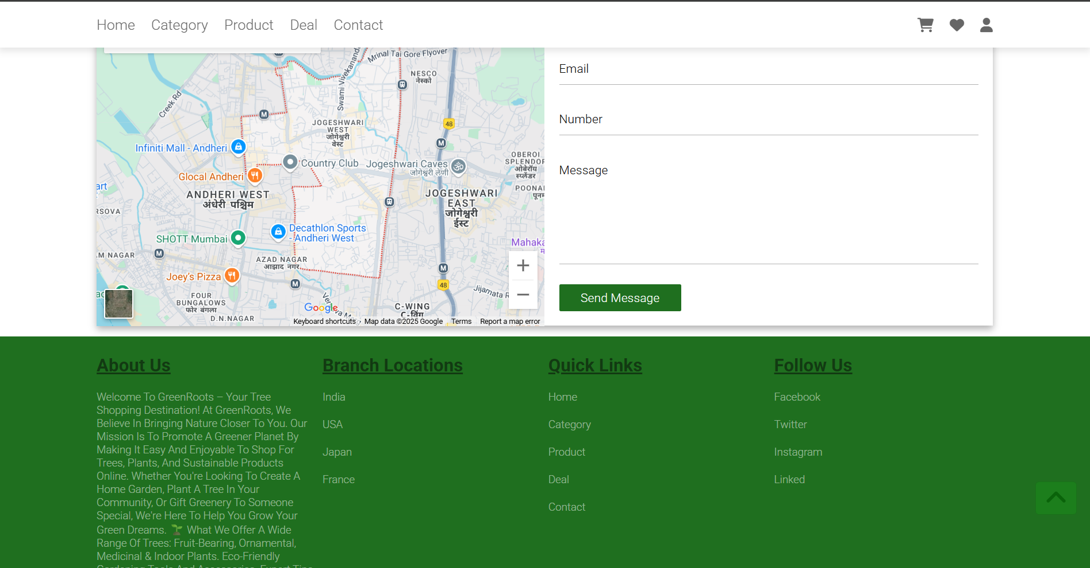

Slide 16
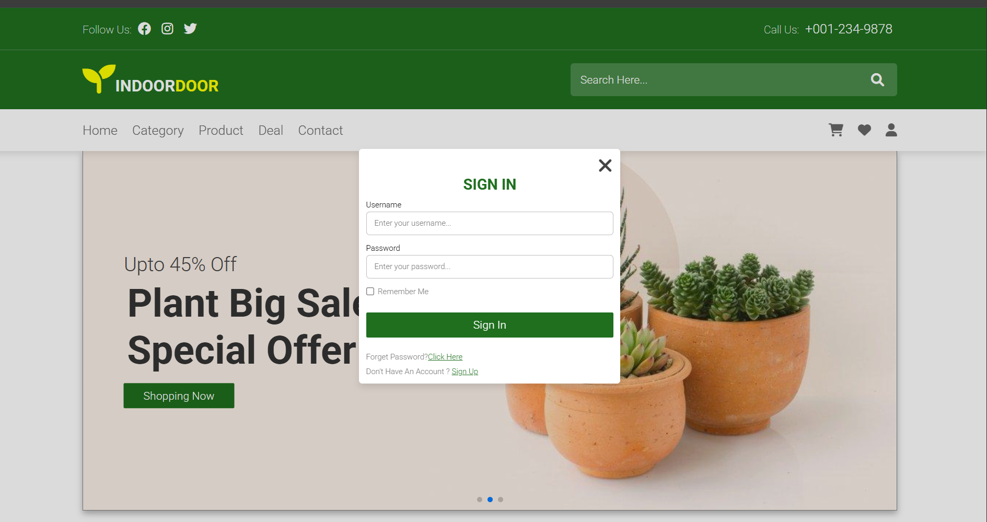

Slide 17
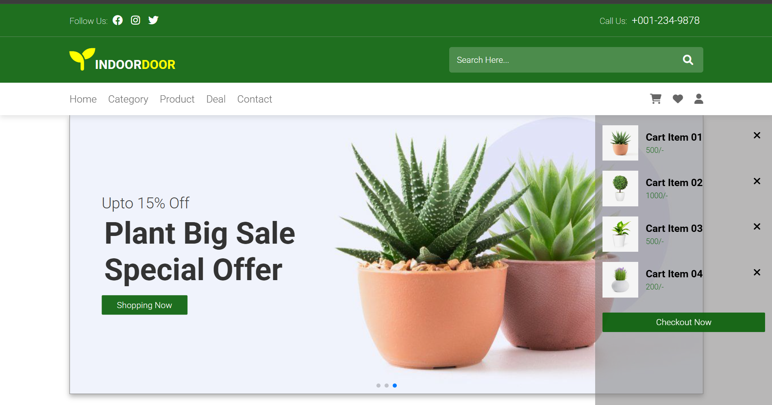

Slide 18
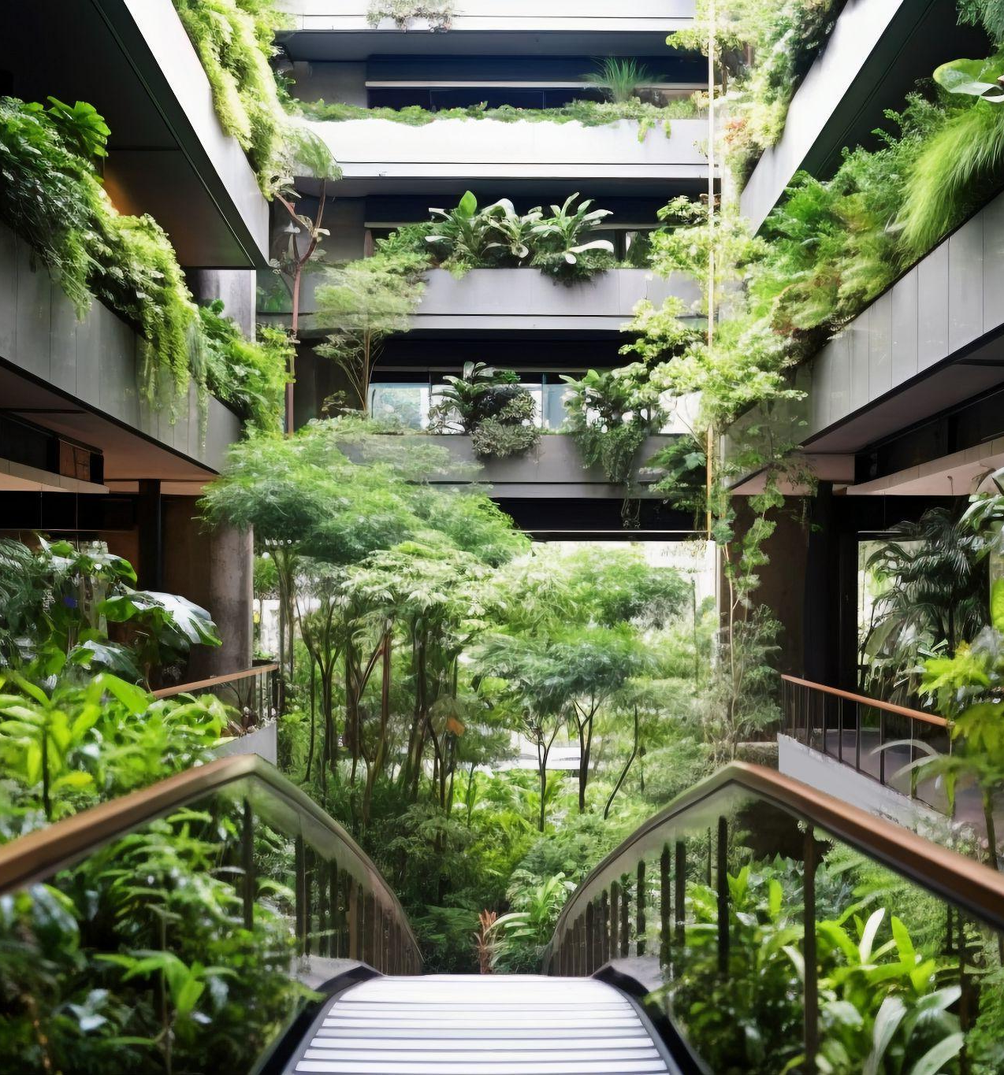
Thank you!
Do you have any questions?
www.yourwebsite.com
↓
CREDITS: This presentation template was created by Slidesgo, and includes icons, infographics & images by Freepik
+00 000 000 000

